Slide 1

CSC 543 Multiprocessing and concurrent programming Spring 2021 Final project
Bob Elward relwa136@live.Kutztown.edu

Slide 2
Project Description
Microsoft C# has numerous Concurrent and Parallel processing options.
The focus here is on a highly productive feature: Task Parallel Library (TPL).
The samples will use .NET Core 5, C# 9.0 and Visual Studio Community 2019.
Keep in mind that these tools can be used to develop applications for:
Windows
Mac OS
Linux
Android
iOS
GitHub Repository: https://github.com/belward1/CSC543FinalProject
Microsoft Tools for KU Students: Student Resources - Computer Science and Information Technology - Kutztown University
Then click on Software -> Azure Dev Tools
Notes:
https://github.com/belward1/CSC543FinalProject

Slide 3
Threads, Tasks and Thread Pools
Tasks are a higher-level concept: tasks are basically a promise to run a method and return when it is done.
Threads are a lower-level concept: Threads are a part of your operating system, and the thread class is a way to manage them.
Leveraging the thread pool: tasks use the thread pool, which is a "pool" of threads that can be used and reused. Creating threads can be expensive, which is why we have the thread pool.
Threads do not naturally return anything: Tasks are able to return an object when they are completed. Which makes them great for executing a method and returning the result asynchronously.
Cancellation tokens: Tasks can use cancellation tokens so that they can be requested to be canceled. This token can be passed along to other tasks which will be canceled as well.
Tasks support async/await: async/await is a simple way to wait for an asynchronous method to finish without blocking the parent method.
Exceptions: Threads cannot cascade an Exception to its parent method. A Task does cascade exceptions to the parent method and are caught via a AggregateException.

Slide 4
Task Parallel Library (TPL)
Starting with .NET Framework 4, the TPL is the preferred way to write multithreaded and parallel code.
According to Microsoft: “The purpose of the TPL is to make developers more productive by simplifying the process of adding parallelism and concurrency to applications. The TPL scales the degree of concurrency dynamically to most efficiently use all the processors that are available. In addition, the TPL handles the partitioning of the work, the scheduling of threads on the ThreadPool, cancellation support, state management, and other low-level details. By using TPL, you can maximize the performance of your code while focusing on the work that your program is designed to accomplish.”

Slide 5
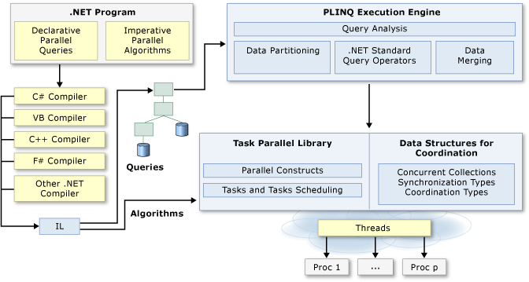
Parallel Programming in .NET
TPL Parallel Class Methods:
Invoke(…)
For(…)
ForEach(…)
Source: Parallel Programming in .NET | Microsoft Docs

Slide 6
JCiP Annotations
Coded C# .NET versions of the Java annotations:
GuardedBy
Immutable
NotThreadSafe
ThreadSafe
See:
Java Concurrency in Practice Brian Goetz, et al Addison-Wesley Copyright © 2006 Pearson Education, Inc. ISBN-10: 0-321-34960-1

Slide 7
Parallel.Invoke(…)
The Parallel.Invoke(…) method has a single signature.
Parallel.Invoke(Action[] // params Action[] actions to execute );
This example will demonstrate invoking three separate actions.
See: How to: Use Parallel.Invoke to Execute Parallel Operations | Microsoft Docs

Slide 8
Loops (for and foreach)
Sequential Loop:
Parallel Parallel.For(…) Loop:
int n = 10;
for (int i = 0; i < n; i++)
{
// … do work
}
int n = 10;
Parallel.For (0, n, i =>
{
// … do work
}
);

Slide 9
Delegate, Anonymous Method and Lambda Expression
Parallel.For third parameter: Action<int>
Named Delegate: Parallel.For(0, n, DoWork); public void DoWork(int i) { // … do work }
Anonymous Method: Parallel.For(0, n, delegate(int i) { // … do work } );
Lambda Expression: Parallel.For(0, n, (i) => { // … do work } );
See: Lambda Expressions in PLINQ and TPL | Microsoft Docs

Slide 10
Parallel.For(…)
The Parallel.For(…) method has 12 overloads.
Parallel.For(Int32 // From inclusive , Int32 // To exclusive , Action<Int32> // Body delegate );
This example will demonstrate tasks running on separate threads.
Delegates, Anonymous functions, Lambda expressions See: Delegates, Lambda Expressions & Closures in C# - Alan Zucconi

Slide 11
Parallel.ForEach(…) Simulated Work
This example demonstrates the value of parallelizing work loads.
You get value from parallelism by having a workload where most of the processing will be spent in the task you are parallelizing, i.e., Amdahl’s Law ☺ !
Also demonstrated is various tuning parameters. But be careful and test when overriding .NET’s default tunning.

Slide 12
Parallel.ForEach(…) with ThreadLocal
The Parallel.ForEach(…) method has 20 overloads.
We’ll look at one that allows for ThreadLocal state:
Parallel.ForEach<TSource,TLocal>(IEnumerable<TSource> // Source , Func<TLocal> // Initialize the local state , Func<TSource,ParallelLoopState,TLocal,TLocal> // Body – once per iteration , Action<TLocal> // Finalize the local state );
This example will sum the elements in an array.

Slide 13
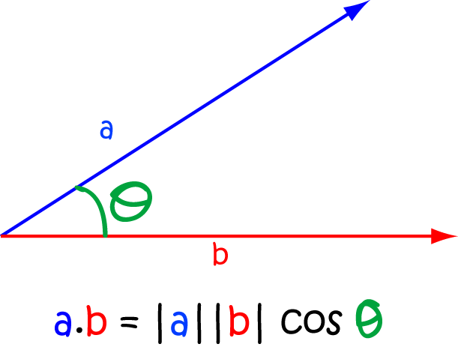
Parallel Dot Product
A real-world calculation found in engineering and mathematics
Dot Product:
Geometric: A • B = |A| * |B| * cos(θ)
Mathematical: Σ ( a_{i} * b_{i} )
Example shows three (3) alternatives:
Sequential
Parallel.For
Parallel.ForEach w/ range Partitioner
Partitioner:
Range partitioning
Chunk partitioning – can dynamically adjust the chunk sizes
See: Custom Partitioners for PLINQ and TPL | Microsoft Docs

Slide 14
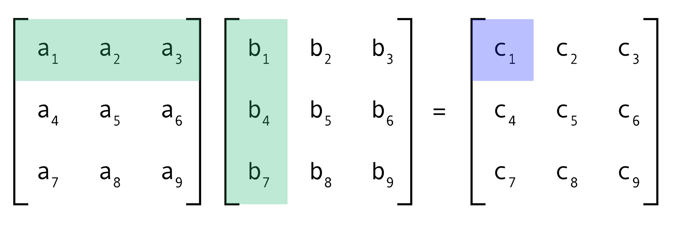
Parallel Matrix Multiplication
A real-world calculation found in engineering and mathematics
Image Reference: More efficient matrix multiplication (fastai PartII-Lesson08) | by bigablecat | AI³ | Theory, Practice, Business | Medium
See: Matrix multiplication - Wikipedia

Slide 15
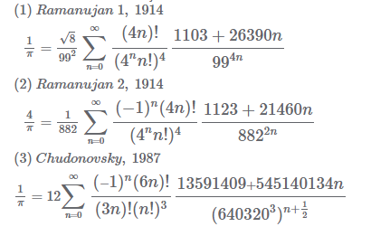
Parallel Pi Calculation
Definition of Pi (See: Pi – Wikipedia): Π = Circumference / Diameter
The value can be calculated using infinite series: (See: 5 Ways to Calculate Pi - wikiHow)
Gregory-Leibniz series: Π = (4/1) – (4/3) + (4/5) – (4/7) + (4/9) – (4/11) + (4/13) – (4/15) …
Nilakantha series: Π = 3 + 4/(2*3*4) – 4/(4*5*6) + 4/(6*7*8) – 4/(8*9*10) + 4/(10*11*12) – 4/(12*13*14) …
More complex series: (See: Pi (Ramanujan's formula) Calculator - High accuracy calculation (casio.com))

Slide 16
Parallel Map Reduce

Slide 17
Books
Concurrency in C# Cookbook Asynchronous, Parallel, and Multithreaded Programming Second Edition, 2019 Stephen Cleary ISBN-13: 978-1-492-05450-4 O'Reilly Media, Sebastopol, CA 95472, USA Copyright Stephen Cleary
Pro C# 9 With .NET 5 Foundational Principles and Practices in Programming Tenth Edition, 2021 (Release May 12) Andrew Troelsen and Philip Japikse ISBN-13: 978-1484269381 Apress Media, LLC, California, USA Springer Science+Business Media New York, USA Copyright 2017 by Andrew Troelsen and Philip Japikse
C# 9 and .NET 5 Fifth Edition, 2020 Mark J. Price ISBN-13: 978-1-80056-810-5 Packt Publishing Ltd., Birmingham B3 2PB, UK Copyright 2020 Packt Publishing

